Slide 1
Classroom Strategy for English Learners
By:
Irma Grijalva-Lopez
Reading and Phonic Class
California Baptist University

Slide 2

Strategy Instruction For English Learners
It promotes interaction with people from different backgrounds and different abilities; it has made this country unique because it is so diverse. It has one goal, to teach its people how to speak and write in English.

Slide 3

English Learners
During the school year of 2014-2015, the State of California has implemented the Common core Standards. This is affecting millions of English Learners, however, such strategies as Graphic Organizers have change the way we teach to English Language Learners.

Slide 4
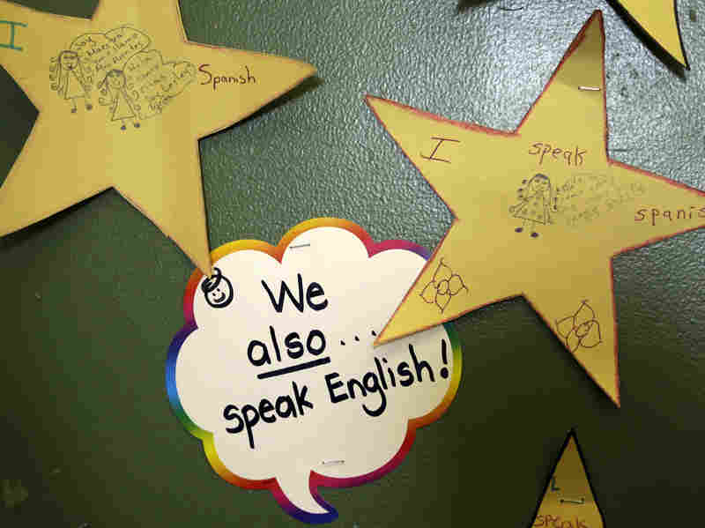
Strategy
Strategies like teaching students to “Use graphic organizers that help them to improve mathematics, reading, comprehension, verbal communication, writing and story problem solving skills” (SIA 8 Components and 30 Features) are tools that can help the students to improve in each activity.

Slide 5

English Language Learners
Even though, these activities demand more designed time, research has demonstrated “The knowledge, skills and abilities students have develop in their primary language can transfer to their development English Language “ CCSS State Board of Education Adopted Chapter 2).

Slide 6

Strategy in Action
Using in a Venn Diagram allows abstract ideas to be more visible, although, it is primarily a thinking tool. For example,
https://www.youtube.com/watch?v=mLIuHU5Sj5w
Video: About What is a Venn Diagram or set Diagram?

Slide 7

“The Lord God has given me the tongue of those who are taught, that I may know how to sustain with a word him who is weary. Morning by morning he awakens, he awakens my ear to hear as those who are taught” Isaiah 50:4

Slide 8
References
ELL/SDAIE Strategies Instructional Strategies used throughout the year. Lecture conducted from California Baptist University, Riverside. (2015, June 16).
New Levine, L., Luken, L., & Ansin Smallwon. The GO TO Strategies: Scaffolding Options for Teachers of English Language Learners, K-12. Retrieved June 16, 2015, from https://calbaptist.blackboard.com/bbcswebdav/pid-2165512-dt-content-rid- 29697126_1/courses/2015-SU-GT-EDU516-A/go-to-strategies (1).pdf
The ELA/ELD Framework.
(2014, July 14). Retrieved June 1, 6.
THOMAS, W., & Collier, V. (2001, June 30). A National Study of School Effectiveness for Language Minority Students Long-Term Academic Achievement. Retrieved June 16, 2015.

